Slide 1
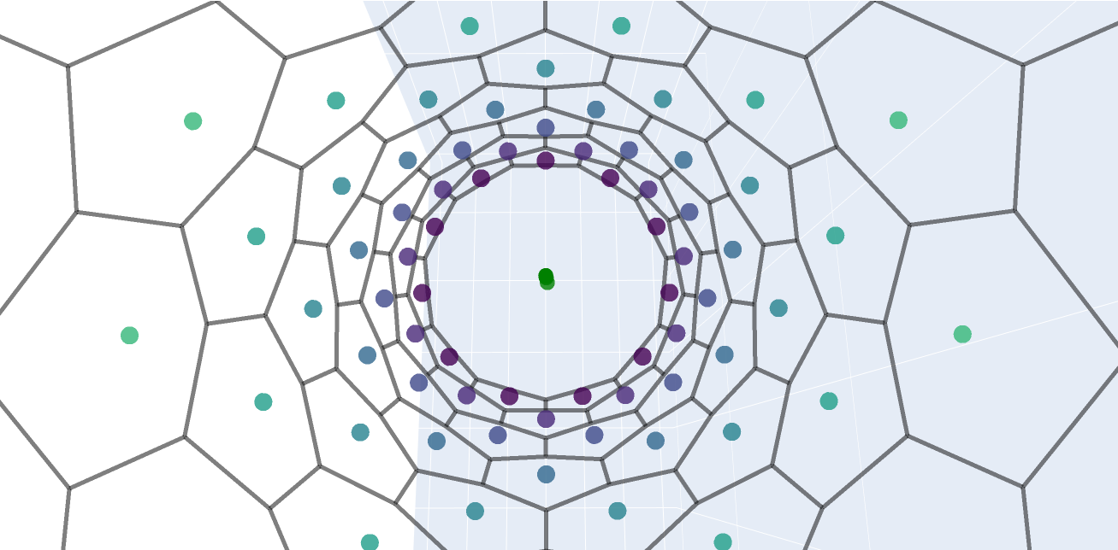
Modelling cell changes in complex morphogenetic processes
Louis Cattin Mota de Campos
under the supervision of Dr Julien Vermot

Slide 2
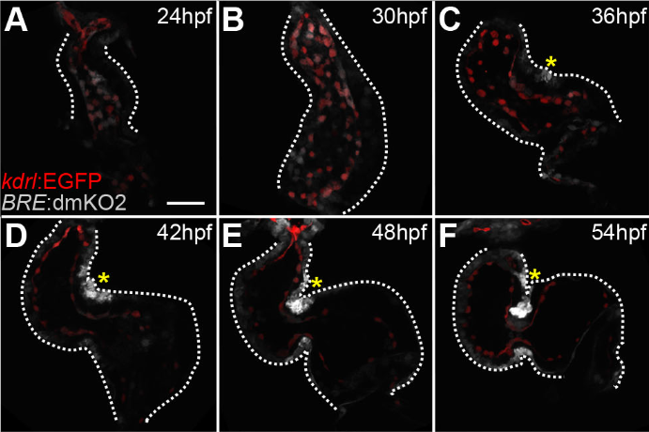
Zebrafish heart morphogenesis
Introduction
Heart tube loops into two chambers between 24 and 48hpf
Heartbeat starts at 24hpf, at around 120bpm
What is the impact of pressure and heartbeat on zebrafish heart morphogenesis ?
LOMBARDO & al. 2019. Morphogenetic control of zebrafish cardiac looping by Bmp signaling. Development

Slide 3
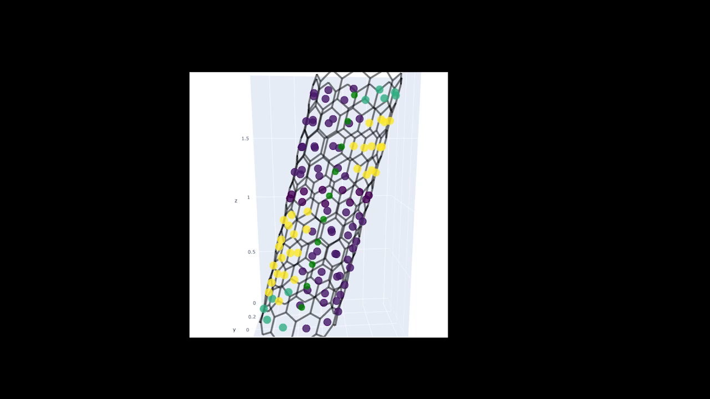
What is the impact of pressure and heartbeat on zebrafish heart morphogenesis ?
Table of contents
Methods
Base model
Volume force
Heartbeat
Results
Shape
Data
Discussion
Takeaways
Drawbacks
Possible improvements

Slide 4
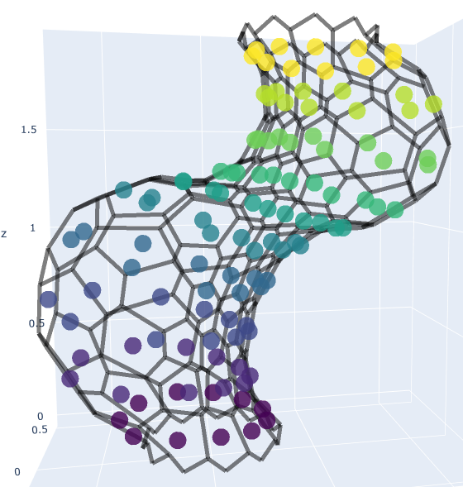
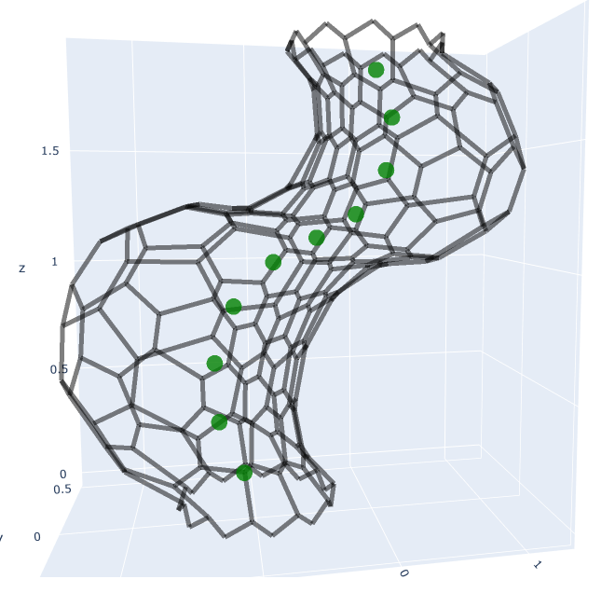
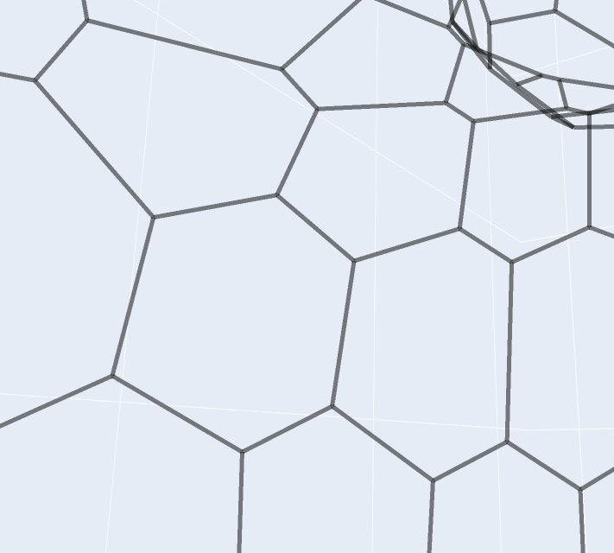
METHODS – BASE MODEL: graphs
Methods
VERTICES:
at the crosspoint between 3 cells
Point of application of forces for evolution
CENTERS:
Useful for area calculations and force direction
Link vertices together as a cell
AXIS POINTS:
Measure looping
Link rings of cells for volume calculations

Slide 5
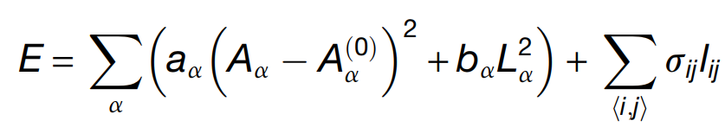
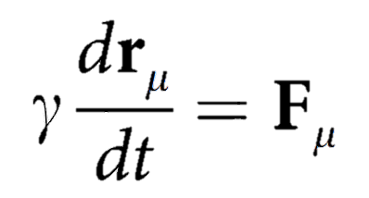
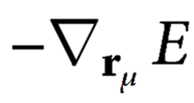
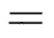
Methods
METHODS – BASE MODEL: Energy model and forces
Perimeter
change
Vertex-to-vertex
tension
Area change
VERTEX MODEL:
+ volume energy
Assumption: Energy must be minimized at all times : can be solved numerically
DYNAMICS:
Step by step approach !

Slide 6
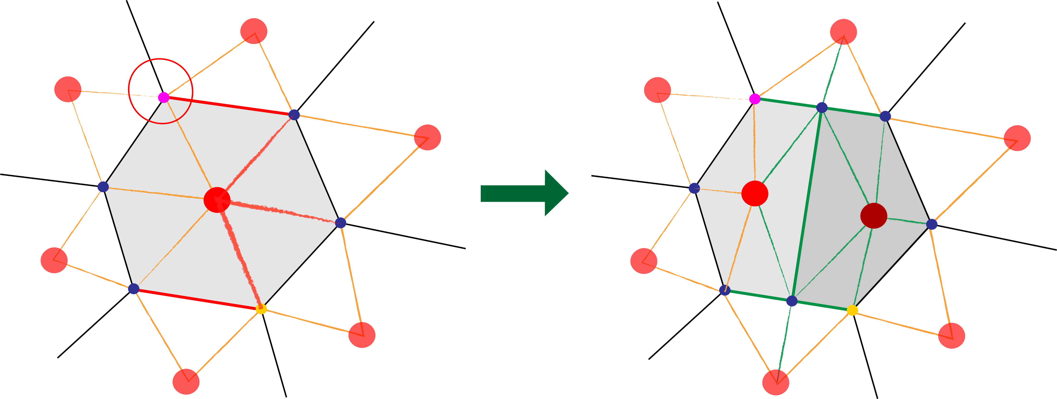
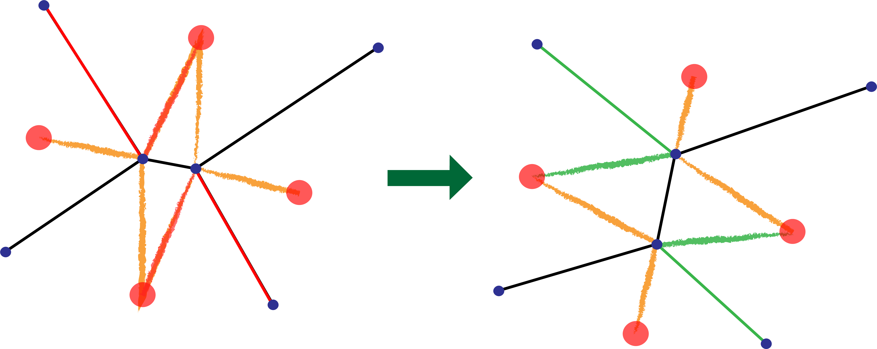
METHODS – BASE MODEL: Division and T1
Methods
Red: edges / connections removed, Green: edges / connections added
CELLULAR DIVISION:
Choosing the circled vertex can orient division
Opposite point chosen as n_vert//2, not geometrical opposite
Maintains 3 edges per vertex
T1 TRANSITION:
Orientation and length of the final junction could induce chirality
Only transition needed for 3-edged vertices

Slide 7
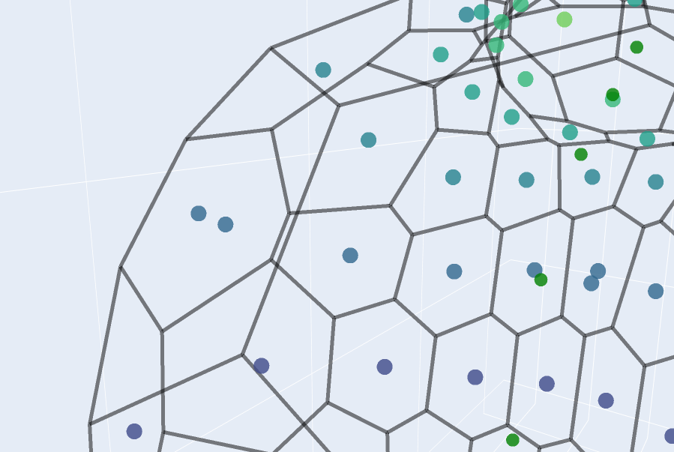
METHODS – Volume force
Methods
Volume = Ring areas * average axis length
FORCE:
Orthogonal to the cell to simulate pressure
Proportional to reference area
Dependent on type of cell : ventricular / atrial cells will be more subjected to it

Slide 8
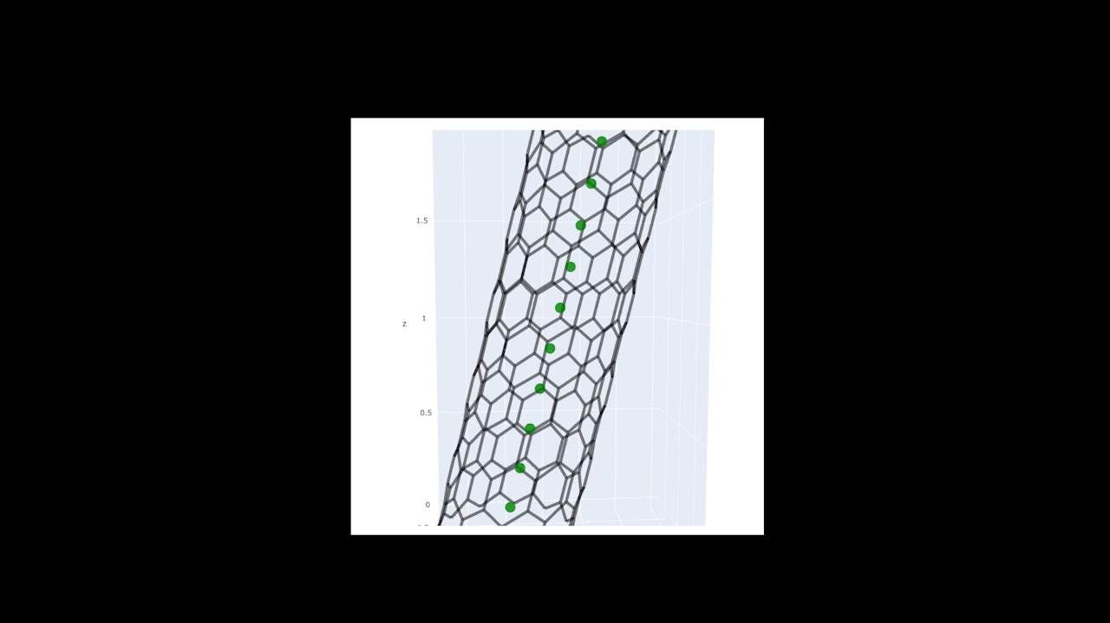
METHODS – heartbeat
Methods
Quickly changing volume : how quick ?
120BPM during 24h : 172800 heartbeats.
Simulation of 600 steps :
Impossible in practice : try and determine difference with much slower beat (3000x slower)
288 beats per step !

Slide 9
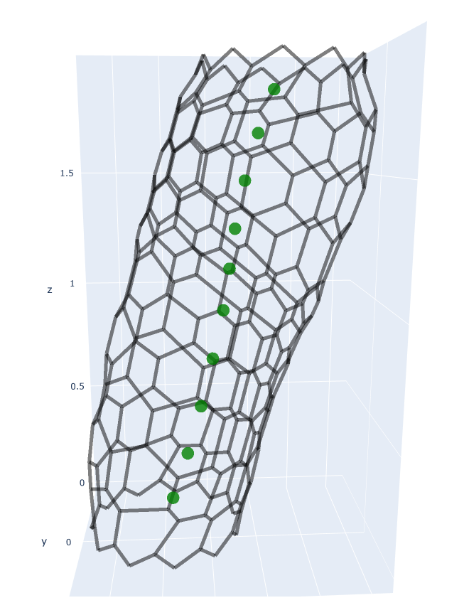
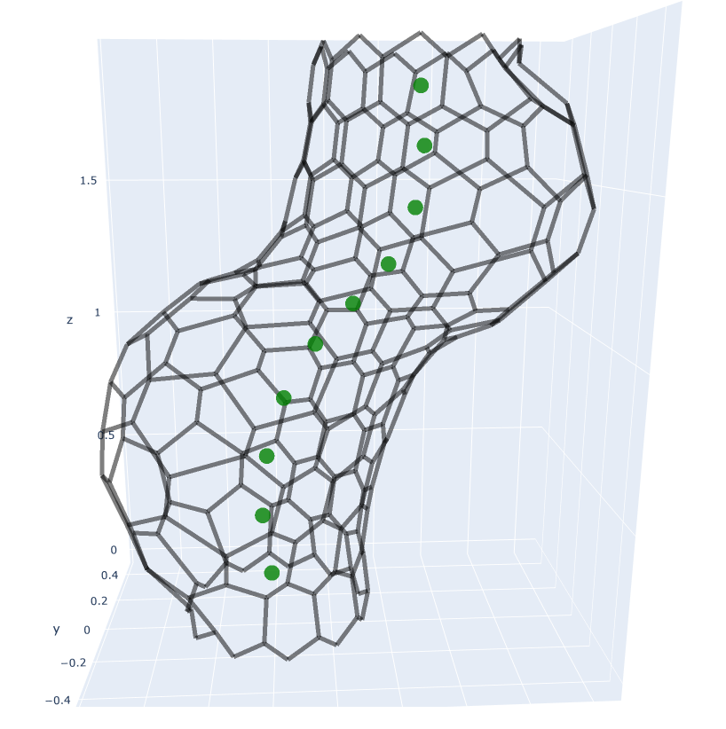
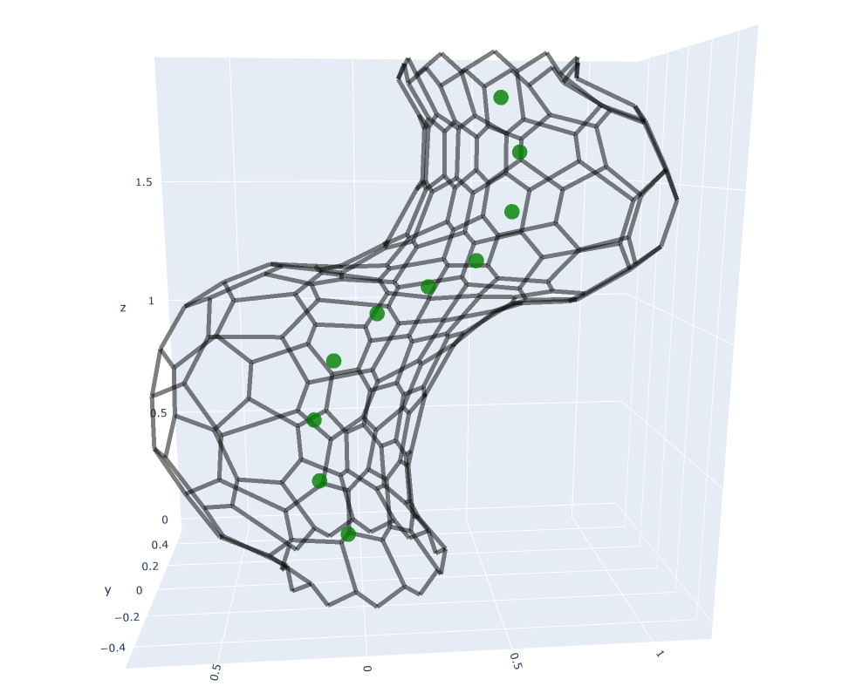
RESULTS – Shape
Results
vol_alpha = 0
vol_alpha = 1
vol_alpha = 2
Increasing volume force = more looping

Slide 10
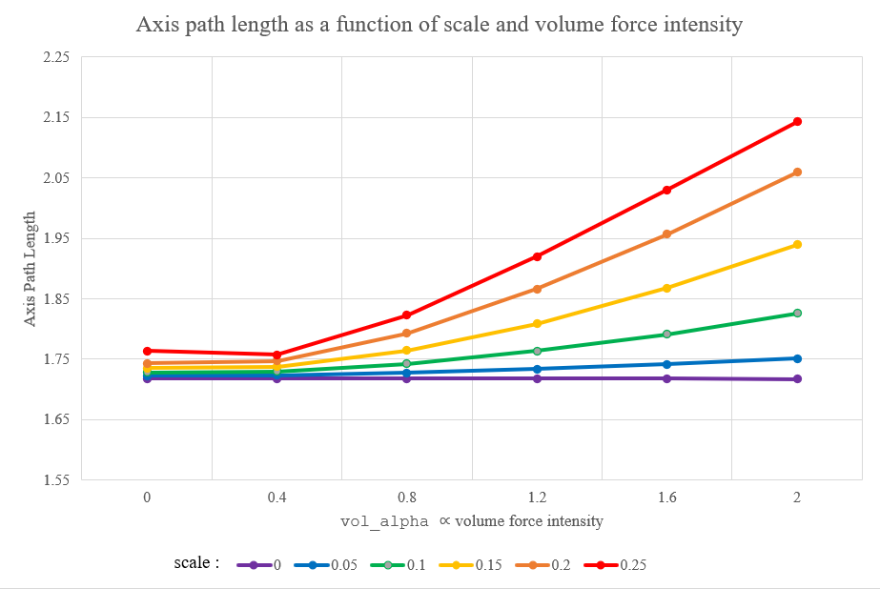
RESULTS – Data: no heartbeat
Results
Up to 25% path length increase !

Slide 11
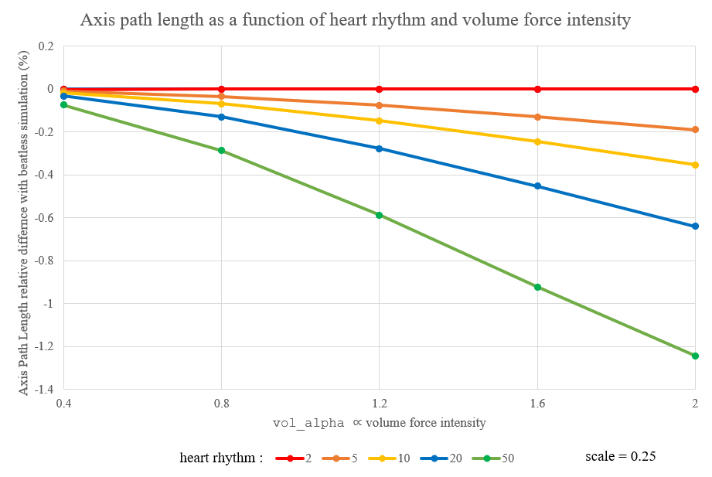
RESULTS – Data: heartbeat
Results
No significant difference to no heartbeat (<1.5%)

Slide 12
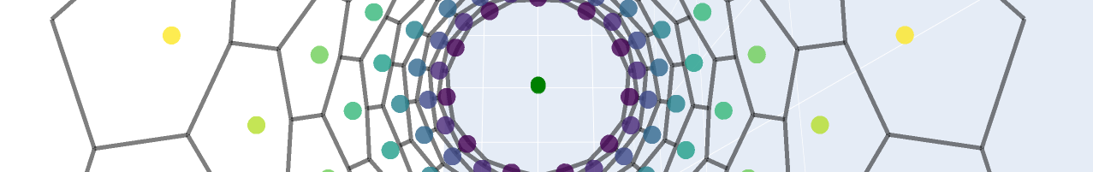
Discussion – Takeaways
Discussion
MODEL:
Introducing macro control to AVMs
Axis points useful for force orientation, measuring results
VOLUME FORCE:
Facilitate looping but not initiate it (yet)
Biological fidelity to the tissue
HEARTBEAT:
Too much of a different timeframe to model in an AVM
Much slower volume-based heartbeat is inconclusive

Slide 13
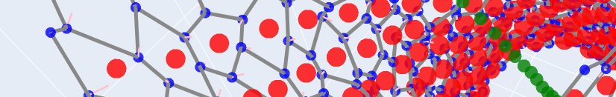
Discussion – Limitations
Discussion
MODEL:
Still too simple to properly model morphogenesis
Only useful as a proof-of-concept tool for certain forces / interactions
VOLUME FORCE:
Real meaning of a pressure force ?
Causality : cell changes cause pressure and volume force ?
HEARTBEAT:
Pertinence of a quasistatic AVM when volume changes 120 times per minute ?
Modelling contraction with volume change, too indirect ?

Slide 14
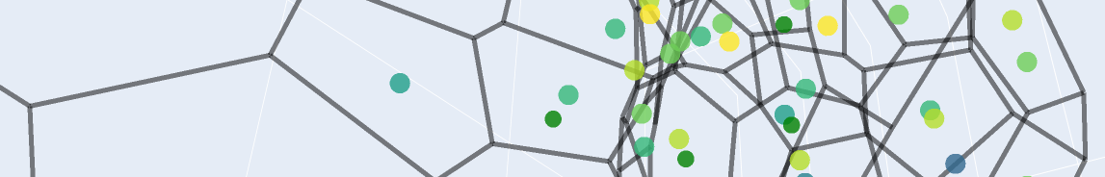
Discussion – Improvements
Discussion
MODEL:
Add better support for mechanotransduction and signalling
VOLUME FORCE:
Constant volume + growing cells should induce twisting: need to find appropriate conditions.
HEARTBEAT:
Determining and implementing the consequences of heartbeat through other means : area, perimeter

Slide 15
Thank you for listening
Any questions ?

